Slide 1
Slide 1
GK Game Reports
A Review of
Phase I
August 3rd – September 3rd , 2024
**Data reflects only those that filed out the report**
Notes:
These can be changed to reflect your school’s specific rules.

Slide 2
Game ID - 13 Key Area’s that went well:
Catching
Punting
Diving
I v I’s / Breakaways
Communication
Distribution
Positioning
Pass Backs
Loose Balls
Free Kicks
Focusing
Angles
Movement Transition

Slide 3
Game ID - 13 Key Area’s that Did Not go well:
Bounces
Punting
High Balls
Distribution
Communication
I v I’s / Breakaways
Positioning
Holding my shots
Decision Making
Organizing
Angles
Footwork
Confidence

Slide 4
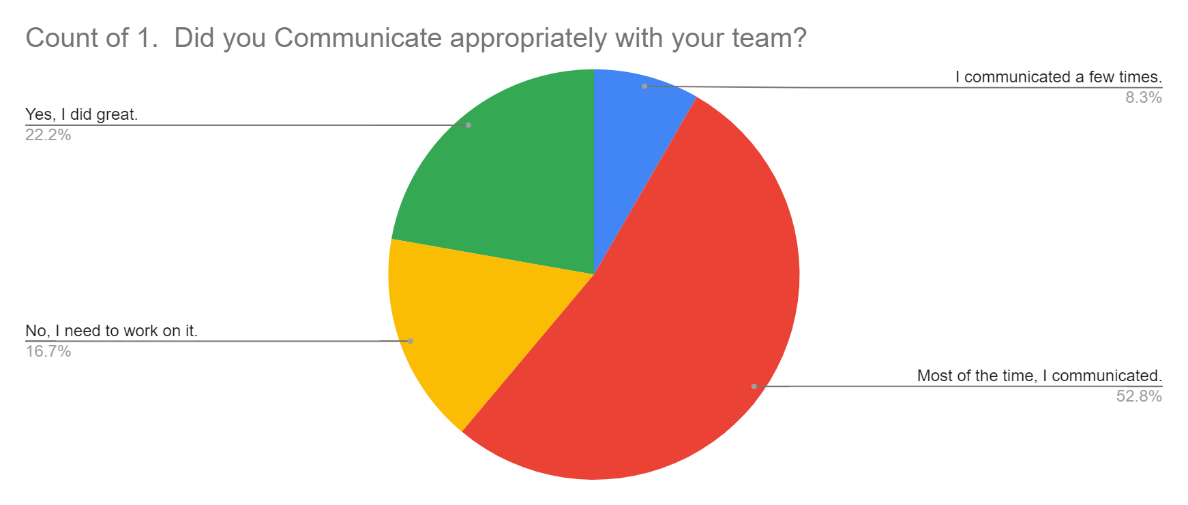
Slide 3
How was your communication:
1. Communication

Slide 5
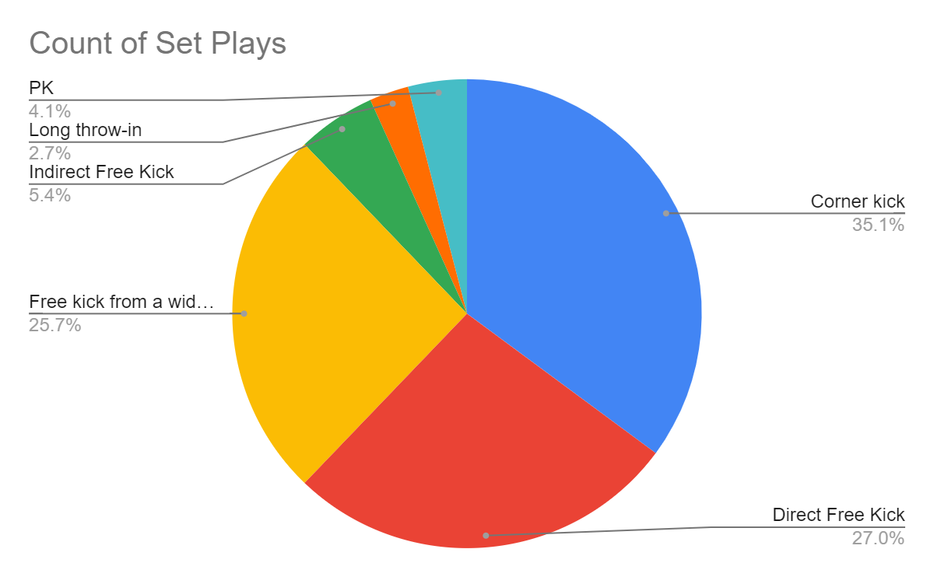
Slide 3
What Set Plays did they encounter:
Corner kicks
Direct Free Kicks
Wide area FKs

Slide 6
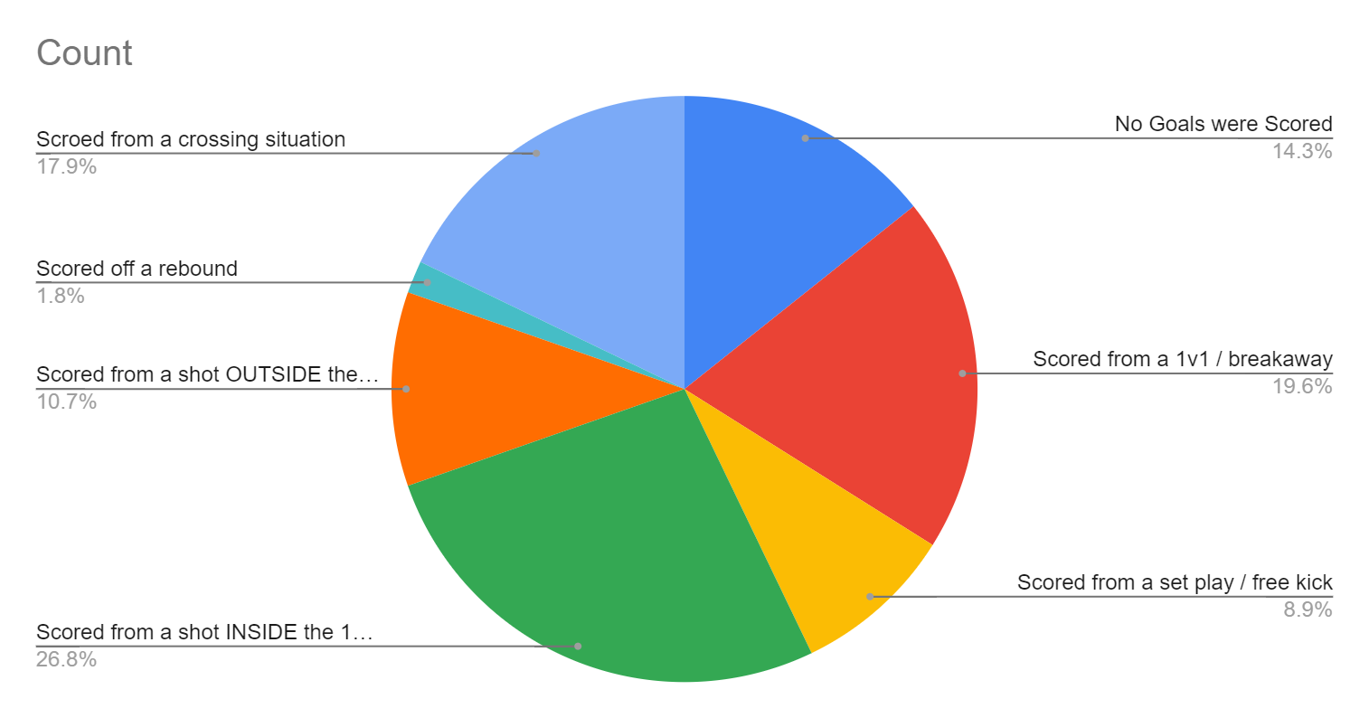
Slide 3
How did they get score on:
1v1 / Breakaway
Shot inside 18
Cross Situation

Slide 7
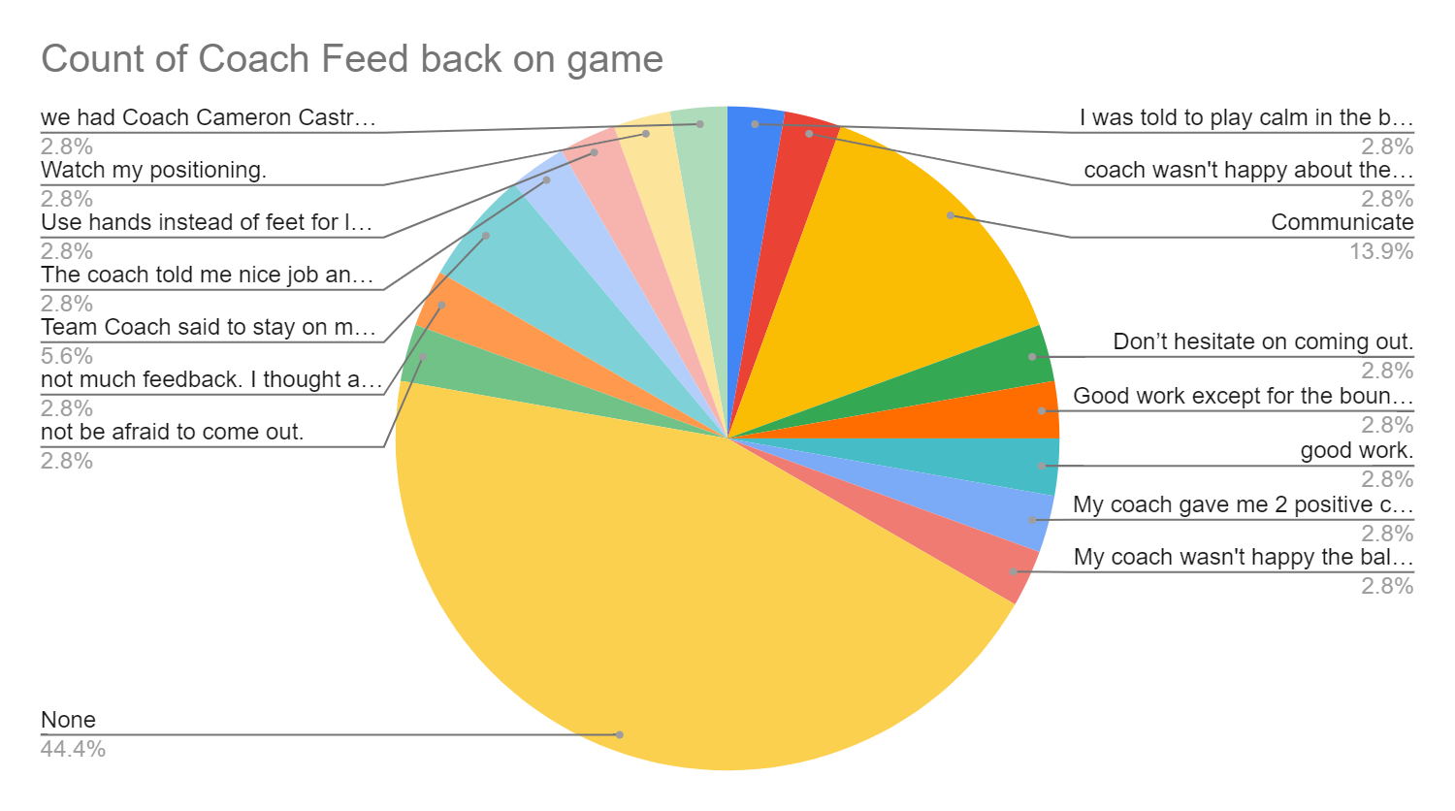
Slide 3
Team coach feedback to the GK:
No feedback
Need to communicate

Slide 8
Slide 3
Communicating in the 1/3 of the field:
Ball in the Def. 1/3
Not sure what to say

Slide 9
Slide 7
Questions ??
Next Game Report is Phase II
~September – October 15, 2024~

