Slide 1
September and November 2024 game report data
Jeff Tackett
Director of Goalkeeping

Slide 2
Metric Dynamics for sept.15 – November 15
Metric | Measurement | Target | Actual | Completed
ECNL/RL | Game reports | B=17 G=21 T=38 | 18 GKs | 52 Reports
9v9 (FC) | Game reports | B=5 G=9 T=14 | 12 GKs | 25 Reports
7v7 (FC) | Game reports | B=8 G=9 T=17 | 5 GKs | 9 Reports
11v11 (FC) | Game reports | B=6 G=13 T=19 | 13 GKs | 14 Reports
Regional Branches (OC,SGV,WV,SB) | Game reports | OC=19 SB=15 SGV=28 T=63 | 3 GKs | 11 Reports
This shows out of 151 goalkeepers in the surrounding club branches from:
Norco, OC, SGV, WV, & SB.

Slide 3
Questions collected:
2 things you did well in the game.
2 things you felt were a barrier for this game.
What type of goals were scored on you?
What type of feedback to you receive from your team coach?
What type of crosses did you encounter in the game?
How many crosses happened during the game?

Slide 4
September and November 2024 game report data
ECNL / ECRL
11v11
9v9
7v7
Jeff Tackett
Director of Goalkeeping

Slide 5
September and November 2024 game report data
ECNL / ECRL
DATA = 18 GKs reported and submitted 52 reports (47% participation)
Jeff Tackett
Director of Goalkeeping

Slide 6
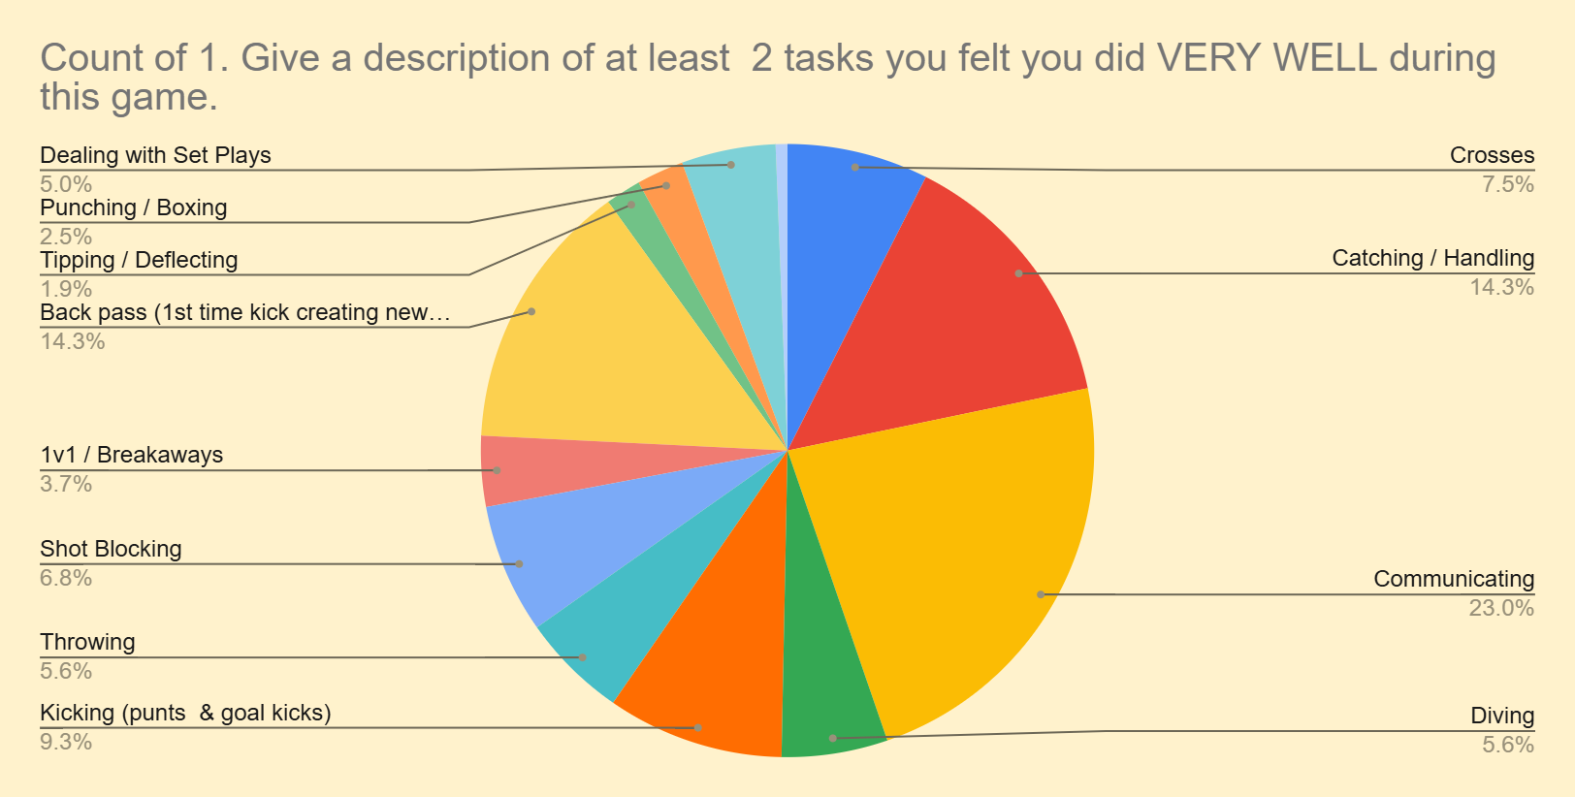
Communicating
Catching/Handling
Back Passes

Slide 7
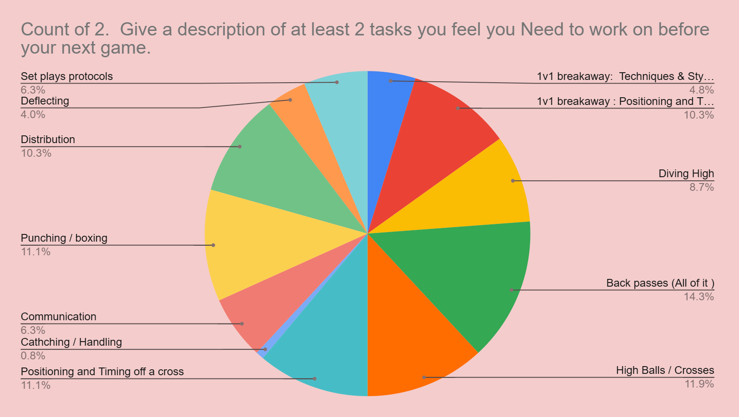
Back Passes
Crosses
Positioning & Timing (Cross)
Punching / boxing
Distribution
Positioning & Timing (1v1s)

Slide 8
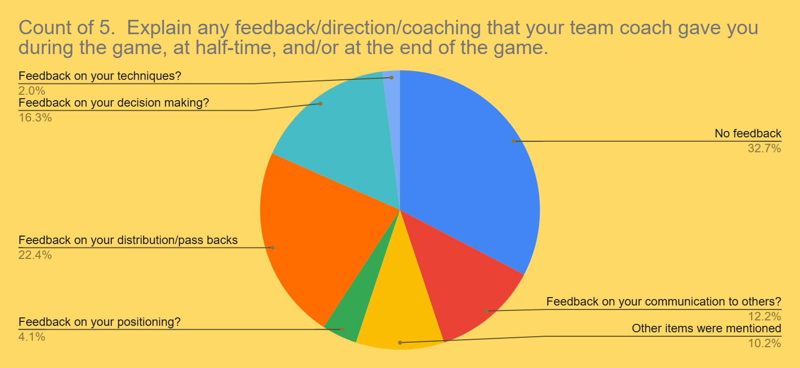
Received feedback on Back passes
Received feedback on Decision making
No Feedback 32.7%

Slide 9
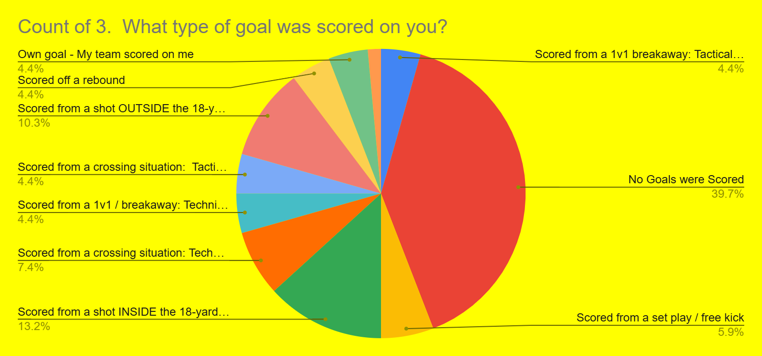
Almost 40% of the GKs did not get scored on during their games in Sept /Oct.
Very few got scored off of a rebounded shot.
Getting scored from inside the 18 was the highest.
Getting scored outside the 18 was 2nd
Dealing with shots needs to be better.

Slide 10
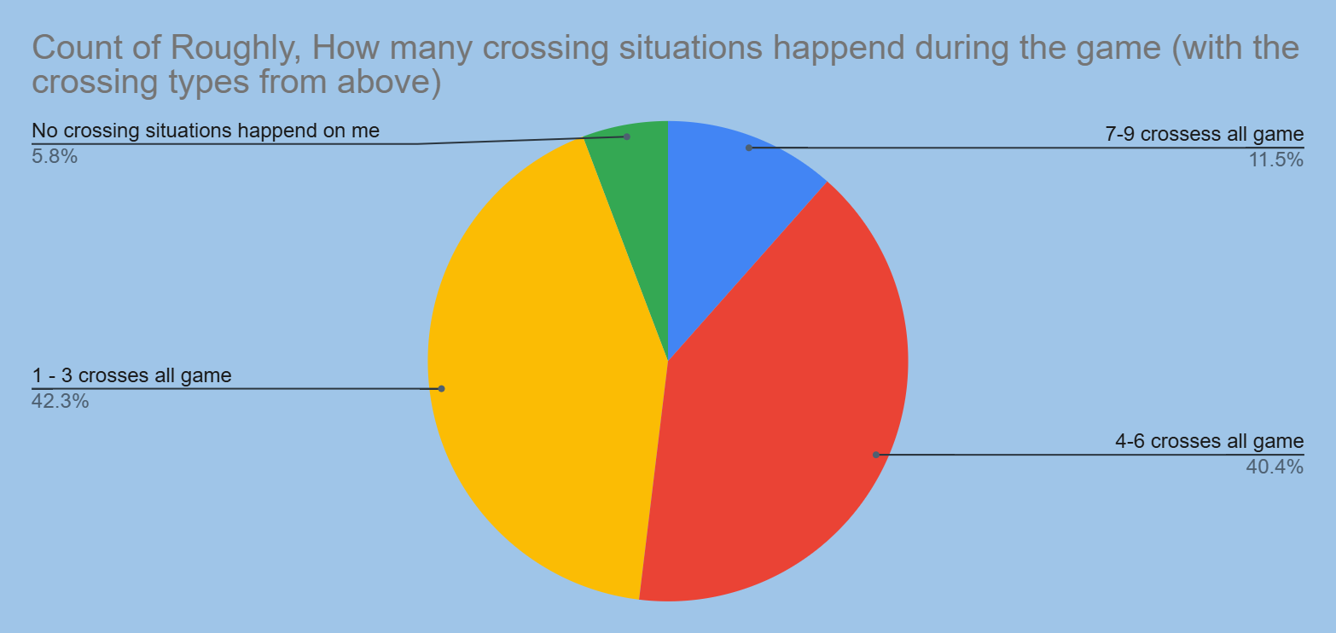
We receive a lot of crosses but do not get scored on from a lot of crosses. 7-10 %
How munch do we really train to be ready for a cross?

Slide 11
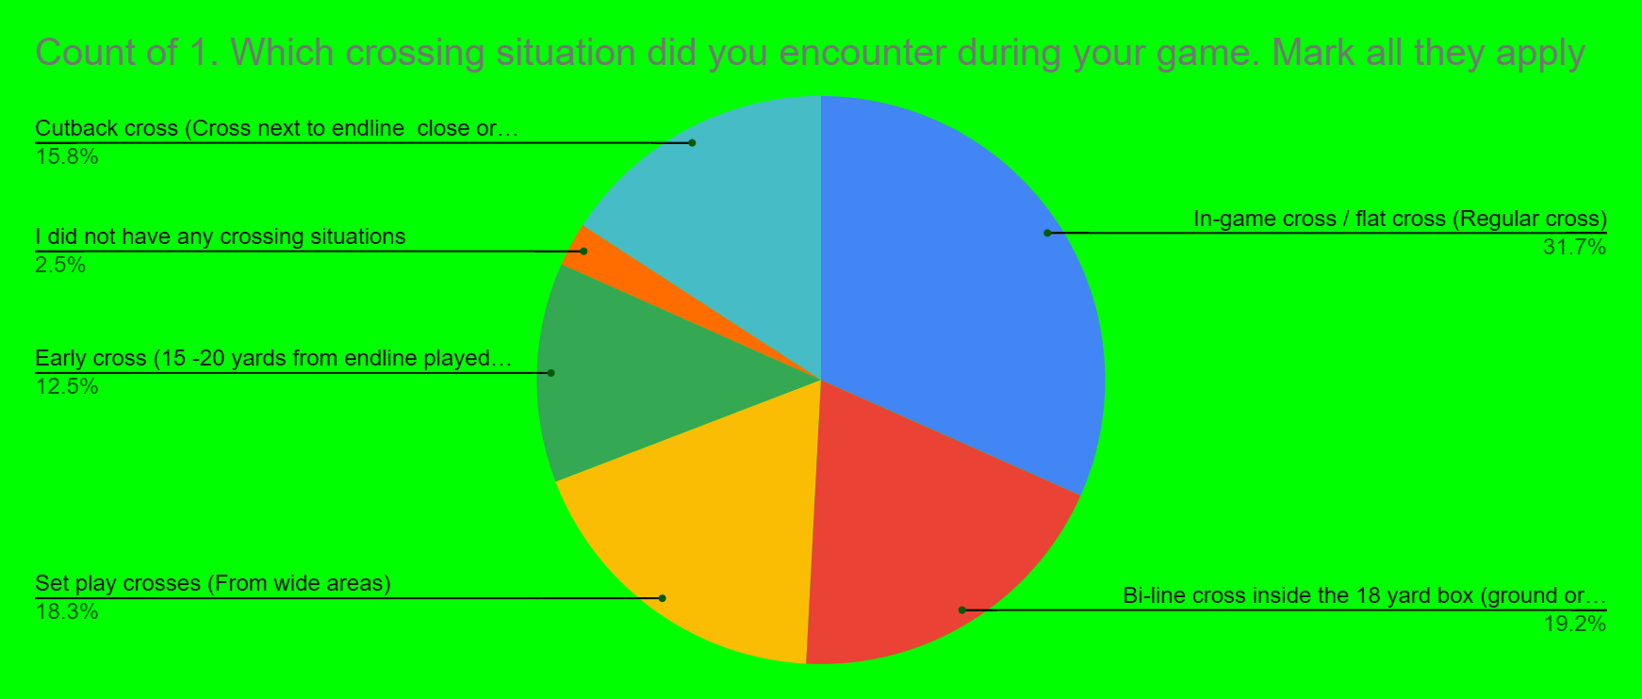
We receive a lot of crosses but do not get scored on from a lot of crosses. 7-10 %
18% of crosses come from set plays

Slide 12
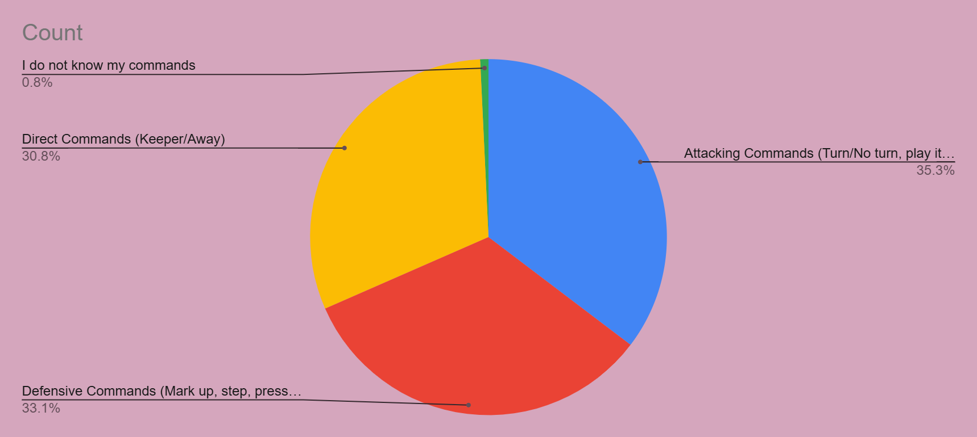
At least 30% were using all commands in the game.
Only 30% communicated
What commands did you use?

Slide 13
Outcome from data: NL/RL
Create more sessions that can work on crosses and back passes. Within those sessions, can we incorporate proper communication during those tasks/situations.
Make each situation more game like so we can also see shots inside the 18 and outside the 18-yard box.
Assist the team in these areas while working with the GKs as often as possible.
Incorporate benchmarks and baselines for GKs as part of their IDPs to help obtain these tasks as a goal and/or milestone.
Recommend that a higher percentage of goalkeepers are taking part in the GK game reports so we can see how the entire club is doing with all topics instead of our sample size date.

Slide 14
Changes that can be made: ECNL /RL
Techniques to be established
Chunk certain topics that are “Spotlight issues” into 3 - 4 week sessions.
Implement any classroom topics that can visually go over these certain topics.
Implement video/game review to show live when these topics are coming up in a positive or a negative situation.

Slide 15
September and November 2024 game report data
9v9 & 11v11 FC
GKs
DATA = 25 GKs reported and submitted 39 reports (75% participation)
Jeff Tackett
Director of Goalkeeping

Slide 16
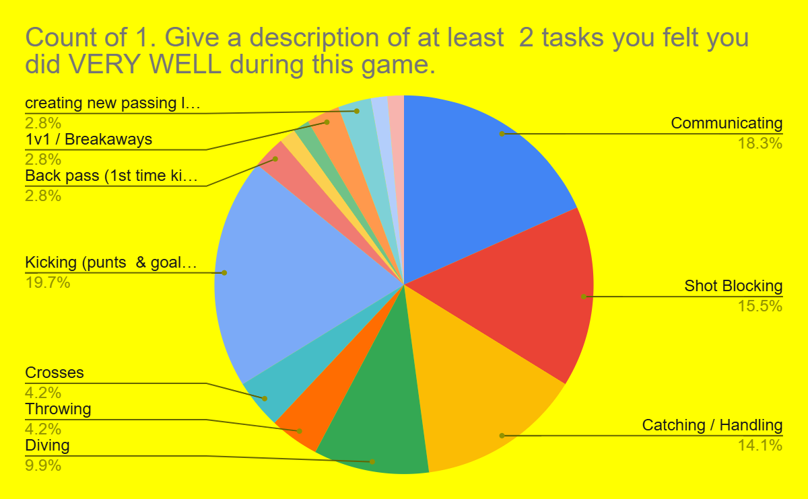
Communicating
Kicking
Catching/Handling
Shot blocking

Slide 17
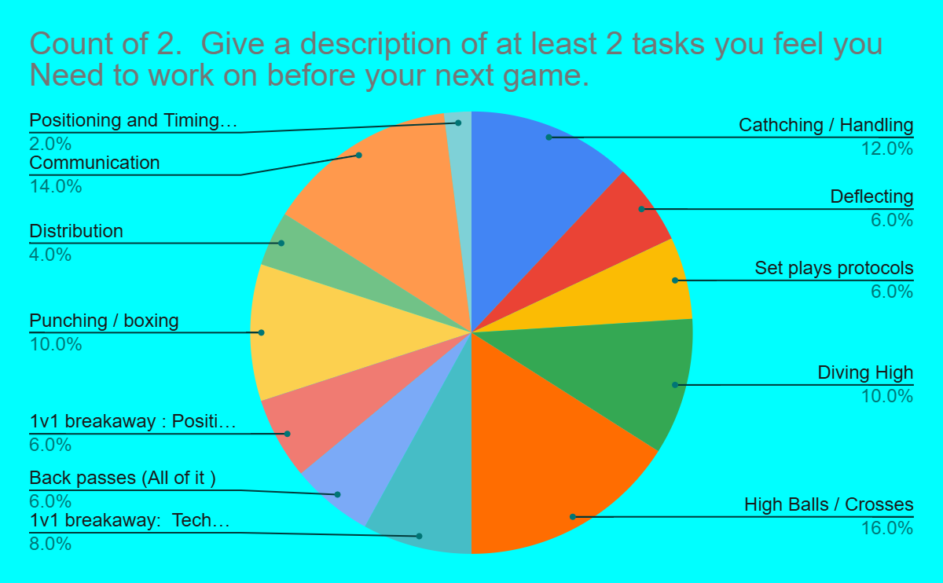
High balls
Communication
Catching / handling
Punching /boxing
Diving high

Slide 18
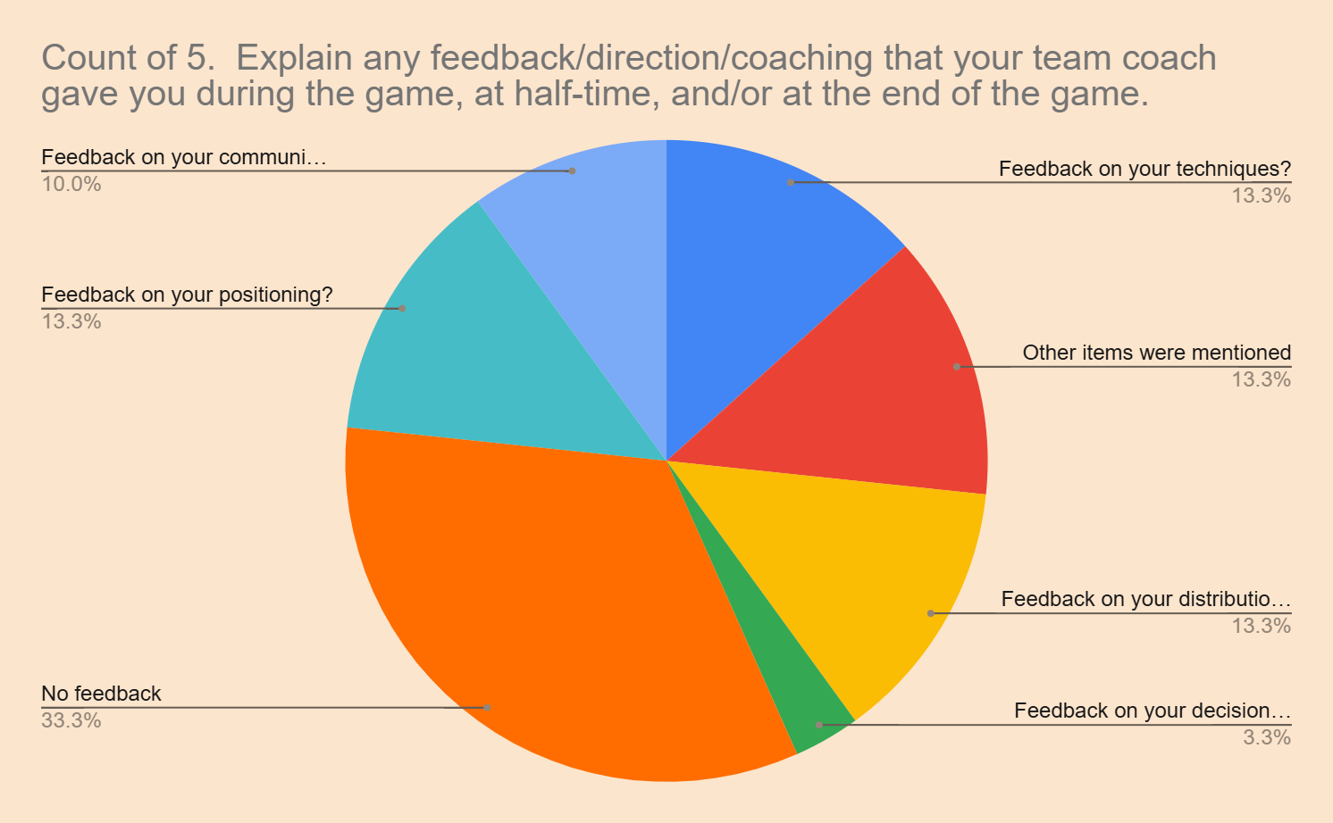
Received feedback on Back passes
Received feedback on Decision making and Position
Gave a variety of feedback so they are talking to the GK
No Feedback 33%

Slide 19
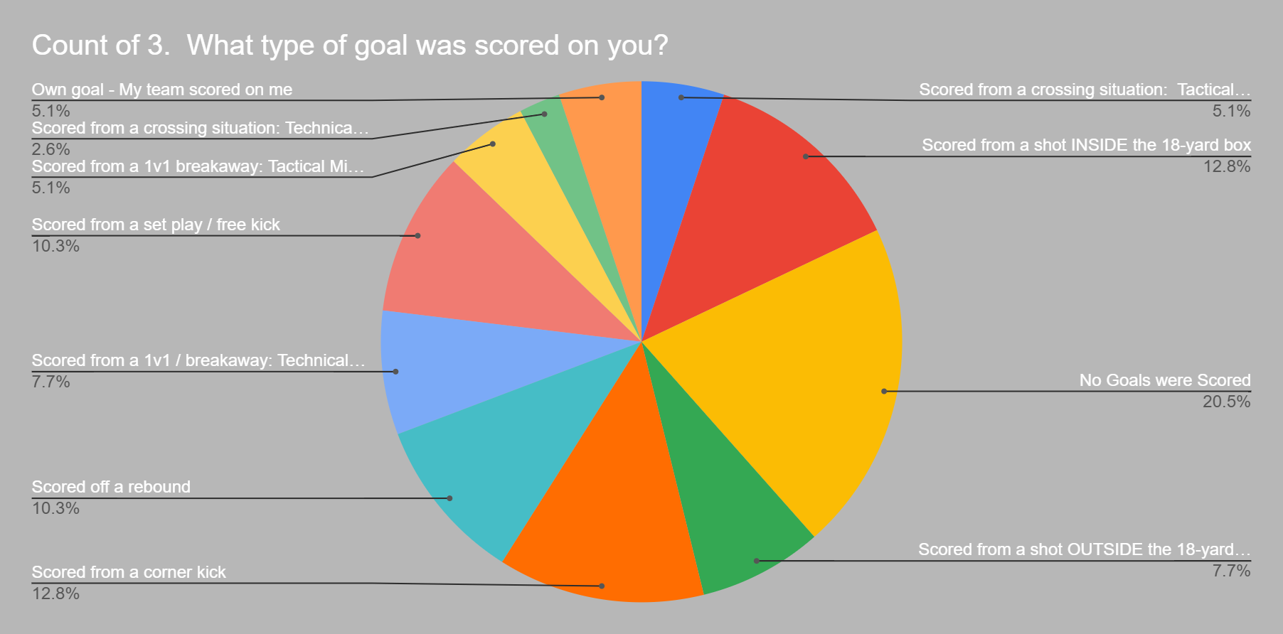
Almost 21% of the GKs did not get scored on during their games in Sept /Oct.
Very few got scored off of a crossing situation and 1v1s.
Getting scored from inside the 18 was the highest.
Getting scored outside the 18 was 2nd
Getting scored off a rebound and set plays

Slide 20
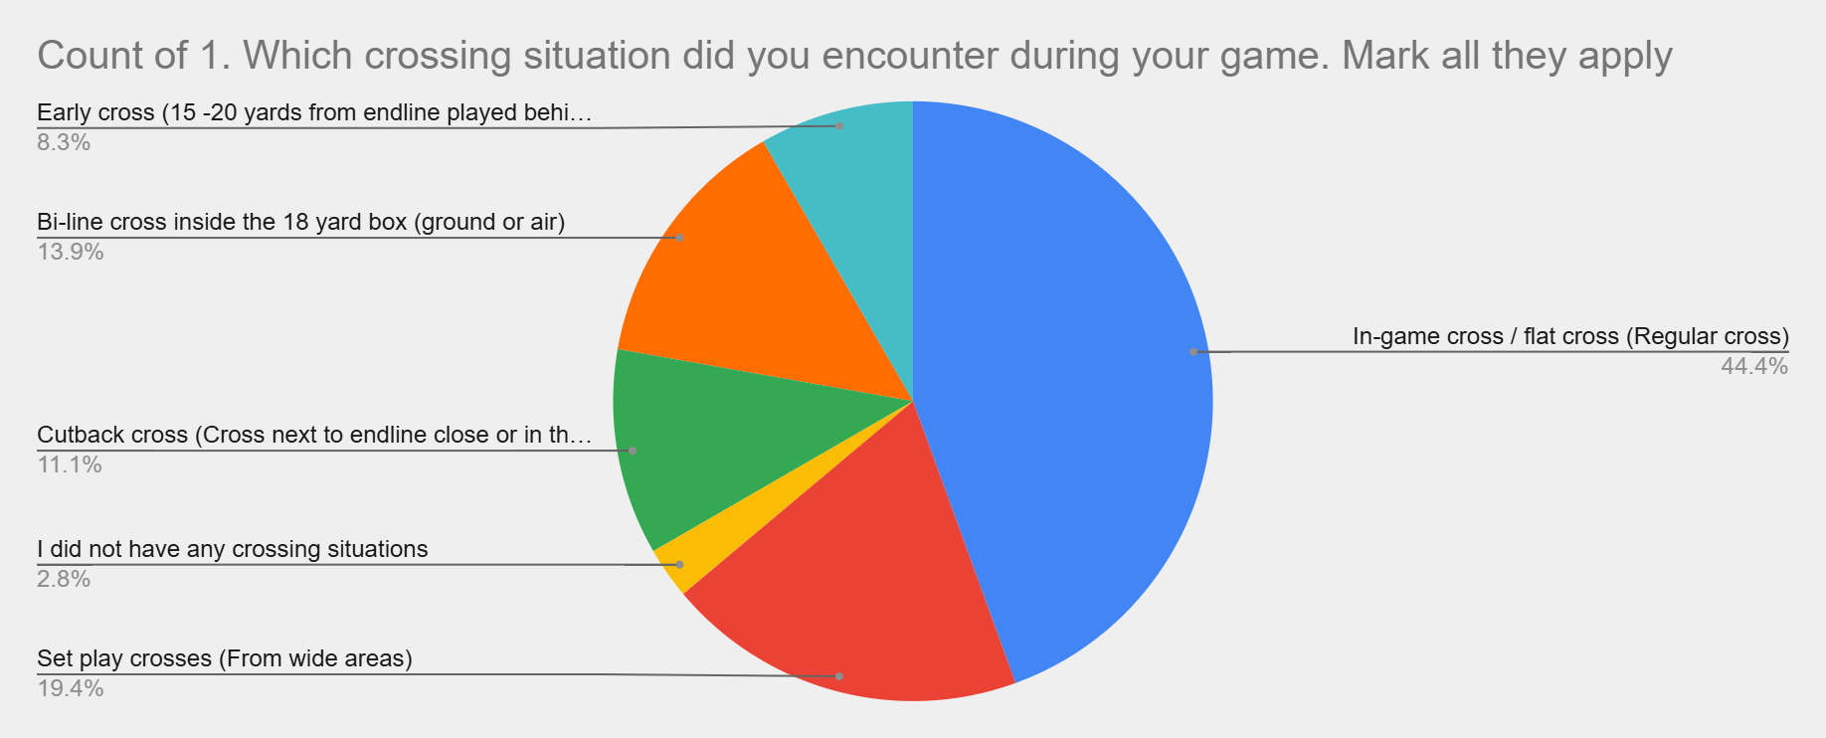
We receive a lot of crosses but do not get scored on from a lot of crosses. 5%
19% of crosses come from set plays
Cutback and byline crosses need to be worked on more.

Slide 21
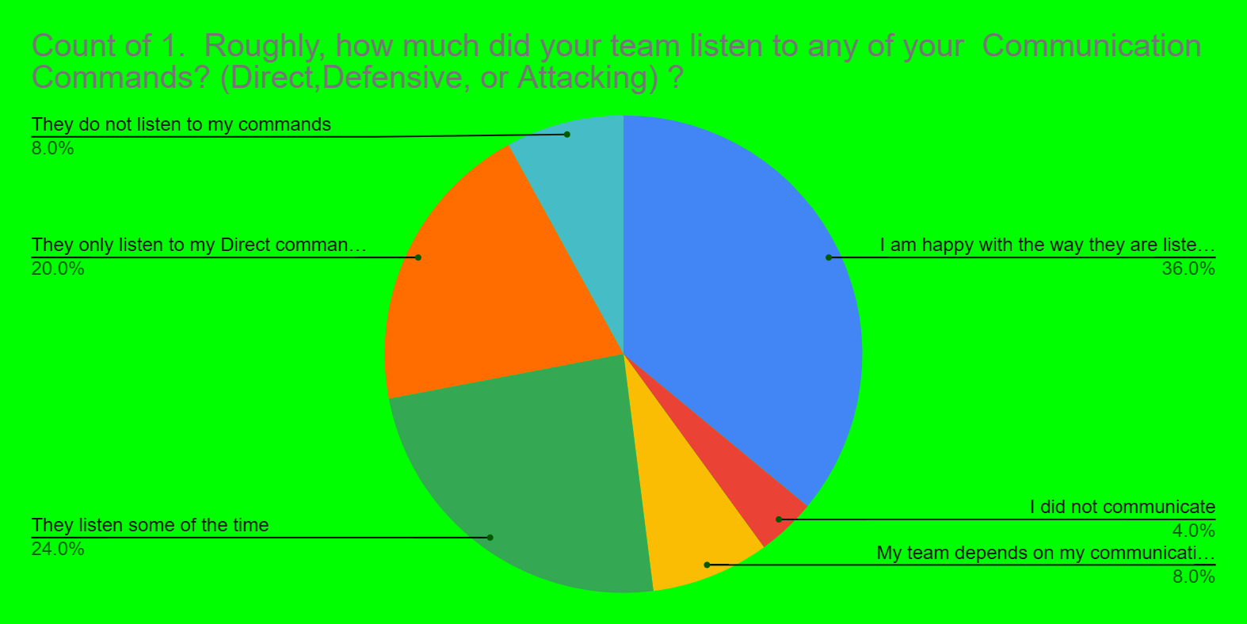
At least 36% were happy with how their teammates listen to them
24% of the GK believe they listen some of the time.
20% say they only listen to Keeper and Away.

Slide 22
Outcome from data 9v9 & 11v11
Create more sessions that can work on crosses and handling shots. Within those sessions, can we incorporate proper communication to have players listen to the GK.
Make shotting drills work on holding the shots and if not making the deflection proper and going wide. Also work on popping up to recover to the next shot.
Assist the team in these areas while working with the GKs as often as possible.
Incorporate benchmarks and baselines for GKs as part of their IDPs to help obtain these tasks as a goal and/or milestone.
Recommend that a higher percentage of goalkeepers are taking part in the GK game reports so we can see how the entire club is doing with all topics instead of our sample size date.

Slide 23
Changes that can be made: 9v9 & 11v11
Techniques to be established
Chunk certain topics that are “Spotlight issues” into 3 - 4 week sessions.
Implement any classroom topics that can visually go over these certain topics.
Make it a point that all saves are held during practice sessions. Create a punishment when they do not hold the shot or do not parry it wide from danger. Also incorporate a recovery shot if this does happen.

Slide 24
September and November 2024 game report data
7v7 GKs
This group was optional to complete the form,
2015s were recommended to complete it.
DATA = 5 GKs reported and submitted 11 reports (29% participation)
Jeff Tackett
Director of Goalkeeping

Slide 25
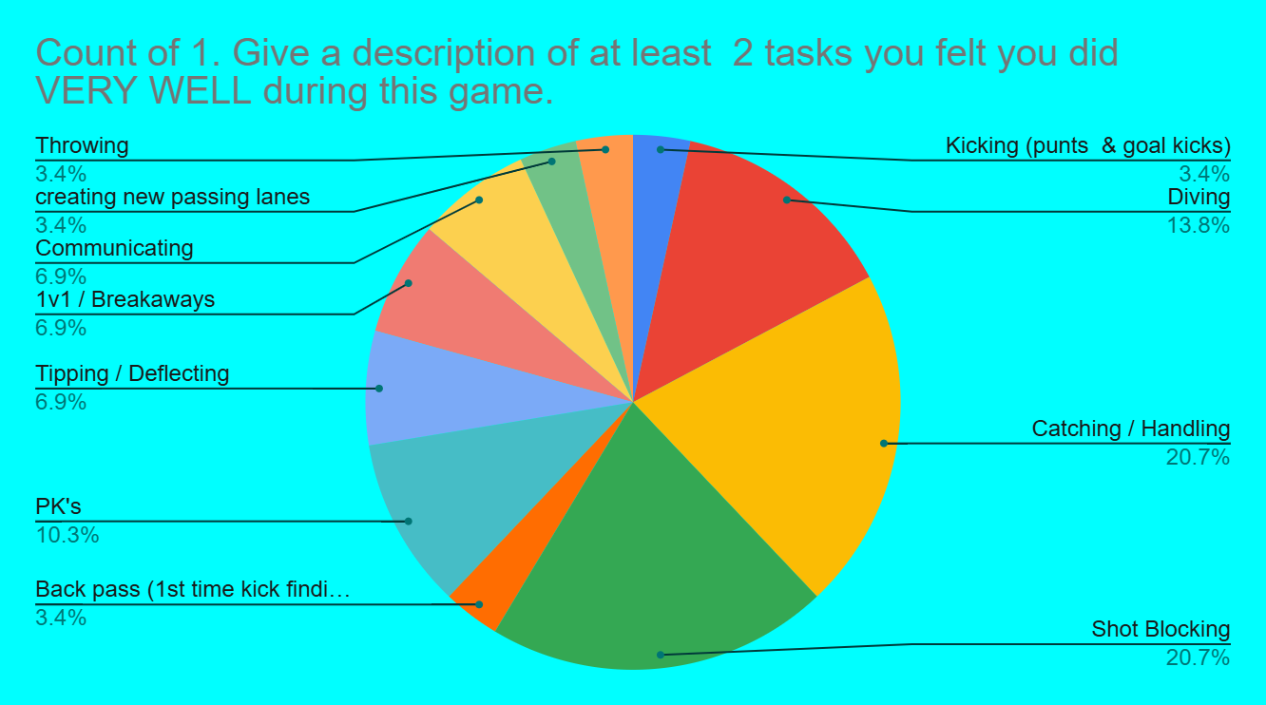
Shot blocking
Catching/Handling
Diving

Slide 26
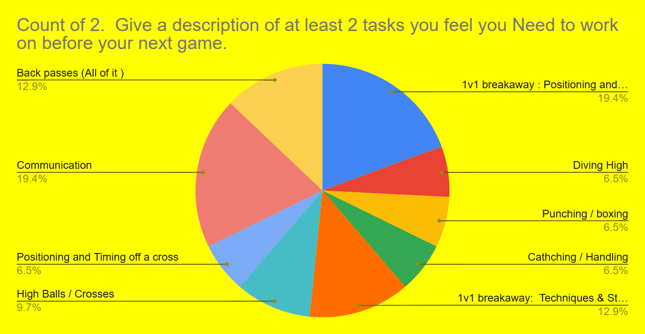
Communication
Positioning & Time (1v1s)
Techniques & Style (1v1s)
Back passes

Slide 27
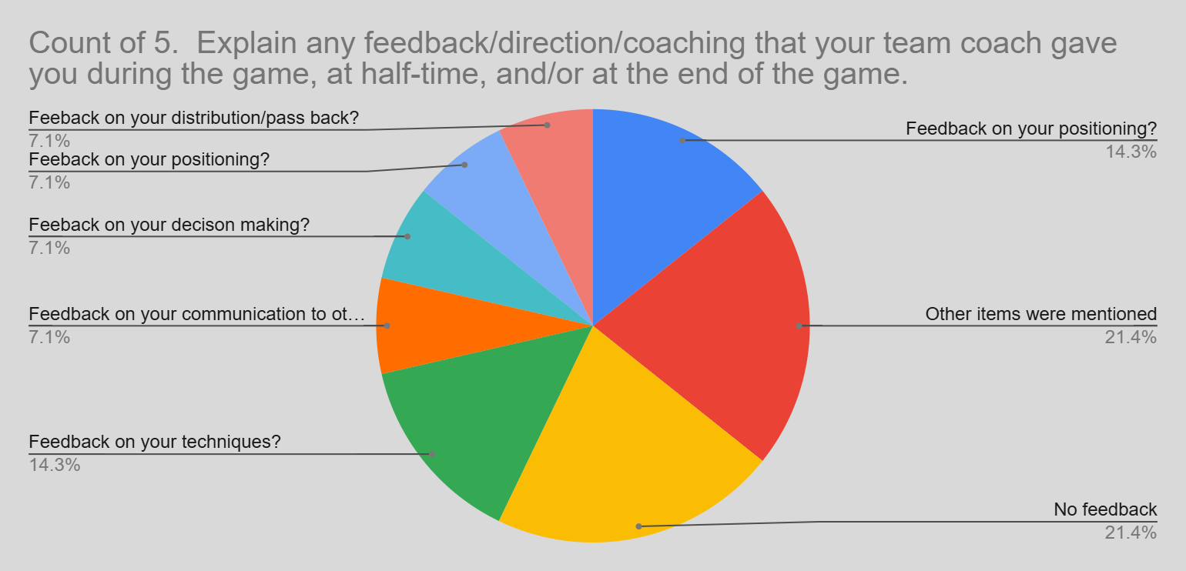
About 14% of the GKs Received feedback on the areas listed.
No Feedback 21%
What were the other items that were talked about?

Slide 28
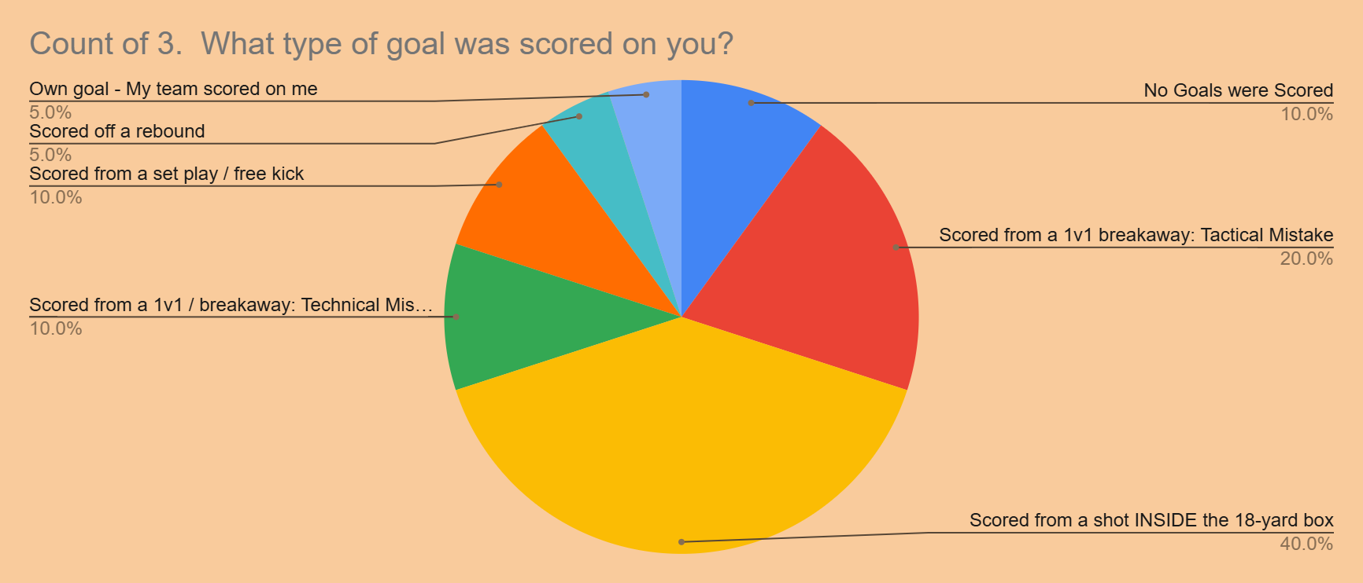
No goals were reported being scored outside the 18-yard box. (Possibly Set-Plays)
No goals from crosses
Getting scored from inside the 18 was the highest.
Getting scored on from 1v1 situations

Slide 29
Outcome from data 7v7
Create more sessions that can work on 1v1 situations and shot blocking scenarios. Within those sessions, can we incorporate proper communication during those tasks/situations. (Keeper & Away)
Assist the team in these areas while working with the GKs as often as possible.
Incorporate benchmarks and baselines for GKs as part of their IDPs to help obtain these tasks as a goal and/or milestone.

Slide 30
Changes that can be made: 7v7 fc gks
Techniques to be established
Chunk certain topics that are “Spotlight issues” into 3 - 4 week sessions.
Implement more game like shots for the GKs to learn the angles of the goal.
Work more on attacking transitions on distribution and back passes.

Slide 31
Thank you

